Slide 1







SMOKE DETECTOR
By – Debabrata Chakraborty (6005)
Vivek Singh (6033)
Shubham Upadhayay (6038)
Pratiksha Joglekar (6064)

Slide 2



INTRODUCTION
A smoke detector is a device that senses smoke, typically as an indicator of fire. Commercial security devices issue a signal to a fire alarm control panel as part of a fire alarm system, while household smoke detectors, also known as smoke alarms, generally issue a local audible or visual alarm from the detector itself.

Slide 3
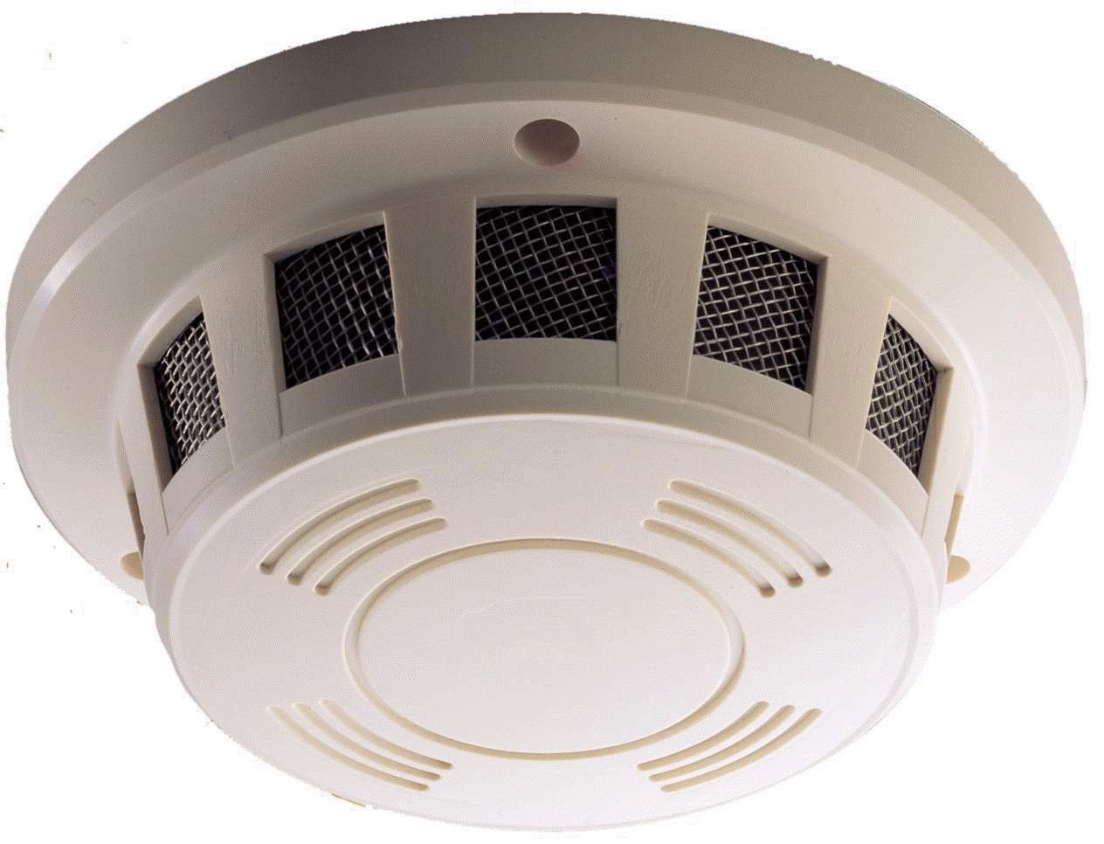
What is SMOKE DETECTION Device?
This SMOKE detector will detect smoke and other harmful gasses such as PROPANE, BUTANE, HYDROGEN, ALCHOHOL etc. and will activate the buzzer.
SMOKE DETECTOR will also alert the authorized person by sending a text SMS, alerting about the smoke detected in the detector.

Slide 4
Why do we need SMOKE DETECTOR?
Detect fire in the areas.
Notify building occupants to take evasive action to escape the dangers of a hostile fire.
Summon organized assistance to initiate or assist in fire control activities.
Initiate automatic fire control & suppression systems & to sound alarm.
Supervise fire control & suppression systems to assure operational status is maintained Initiate auxiliary functions involving environmental, utility & process controls.

Slide 5

What are the different types of SMOKE ALARM?
Ionisation Alarm
Photoelectric Alarm

Slide 6
IONIZATION ALARM
As smoke particles enter the smoke chamber, the smoke particles attach themselves to the ionized air molecules and the air in the chamber becomes less conductive
When the air conductivity within the chamber drops below a predetermined level, the alarm is triggered

Slide 7
Battery
AMERICIUM - 241

Slide 8
PHOTOELECTRIC ALARM
The photoelectric type detector utilizes light as a detection mechanism.
A photoelectric, or optical, smoke detector contains a source
of infrared, visible, or ultraviolet light, a lens, and a photoelectric receiver (typically a photodiode).
There are two types of photoelectric smoke detectors:
• Light sensing(scattering)
• Light obscuring(blocking)

Slide 9
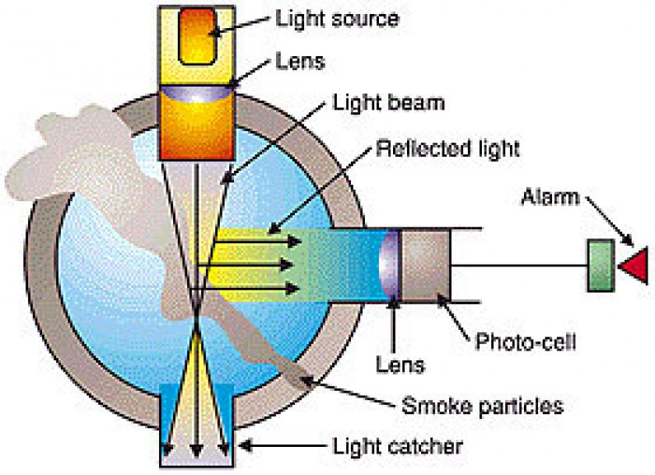
PHOTOELECTRIC ALARM

Slide 10
WHICH IS BEST, IONIZATION OR PHOTOELECTRIC?
According to a detailed study by the US National Institute of
Standards and Technology: "Ionization type alarms provided
somewhat better response to flaming fires than photoelectric
alarms, and photoelectric alarms provide (often) considerably
faster response to smoldering fires than ionization type
alarms." Smoke detectors are trivially inexpensive compared to
the cost of fire damage—and life, of course, is priceless.
Although any smoke alarm is better than none, fit both types
of detector if you possibly can.

Slide 11
SMOKE DETECTOR
Detect SMOKE….
…will also DETECT LPG, BUTANE, PROPANE, METHANE, ALCOHOL and HYDROGEN. (mq2 sensor)
Can DETECT SENSETIVE smoke as well.
If Smoke Detector detects smoke than the authorized PERSON will get notification alert in his phone app instantly.

Slide 12
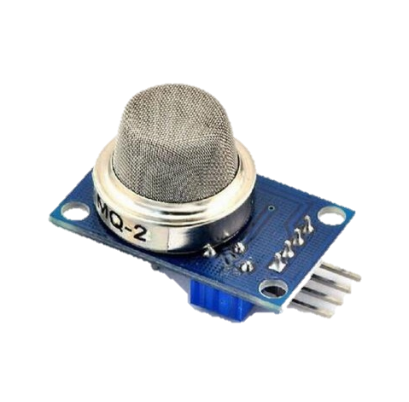
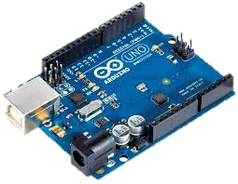
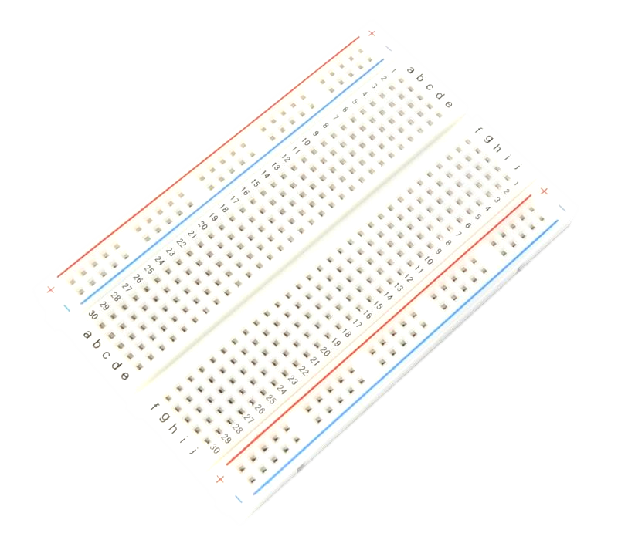
COMPONENTS
ARDUINO BOARD
MQ2 SENSOR
BREADBOARD

Slide 13
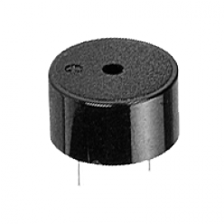
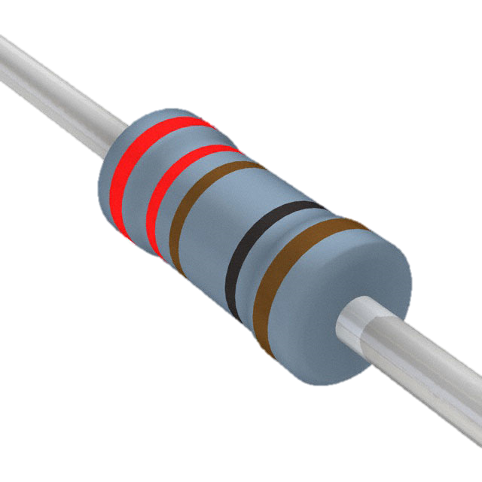
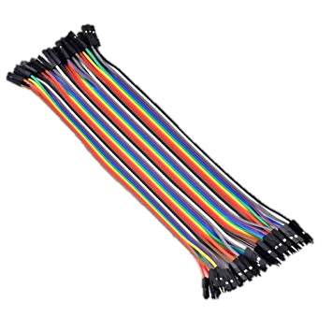
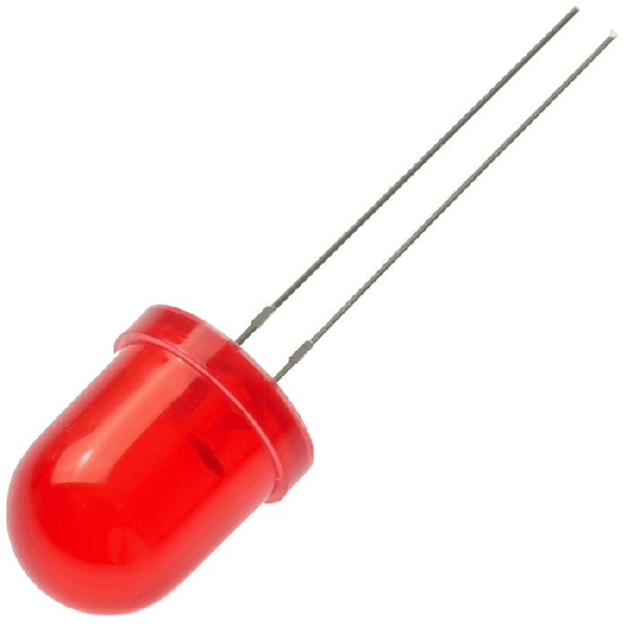
COMPONENTS
BUZZER
221 Ohm Resistor
Jumper Cables
LED’s

Slide 14
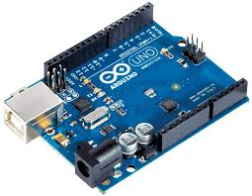
What is ARDUINO board or ARDUINO?
Arduino is an open-source platform used for building electronics projects. Arduino consists of both a physical programmable circuit board (often referred to as a microcontroller) and a piece of software, or IDE (Integrated Development Environment) that runs on your computer, used to write and upload computer code to the physical board.

Slide 15
USE of ARDUINO
Arduino or Arduino boards can be used to build our own PERSONAL projects by implementing once personal code into the Arduino board so that the Arduino board responds and gives the specific output the user wants.

Slide 16
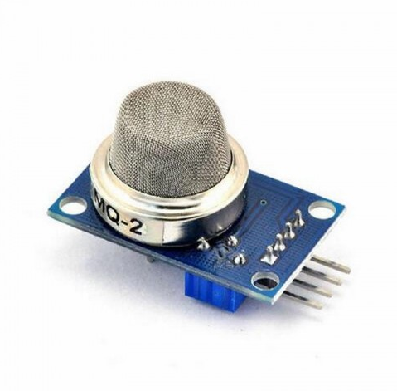
How does MQ2 sensor works?
How does it Work?
The voltage that the sensor outputs changes accordingly to the smoke/gas level that exists in the atmosphere. The sensor outputs a voltage that is proportional to the concentration of smoke/gas.
In other words, the relationship between voltage and gas concentration is the following:
The greater the gas concentration, the greater the output voltage
The lower the gas concentration, the lower the output voltage

Slide 17
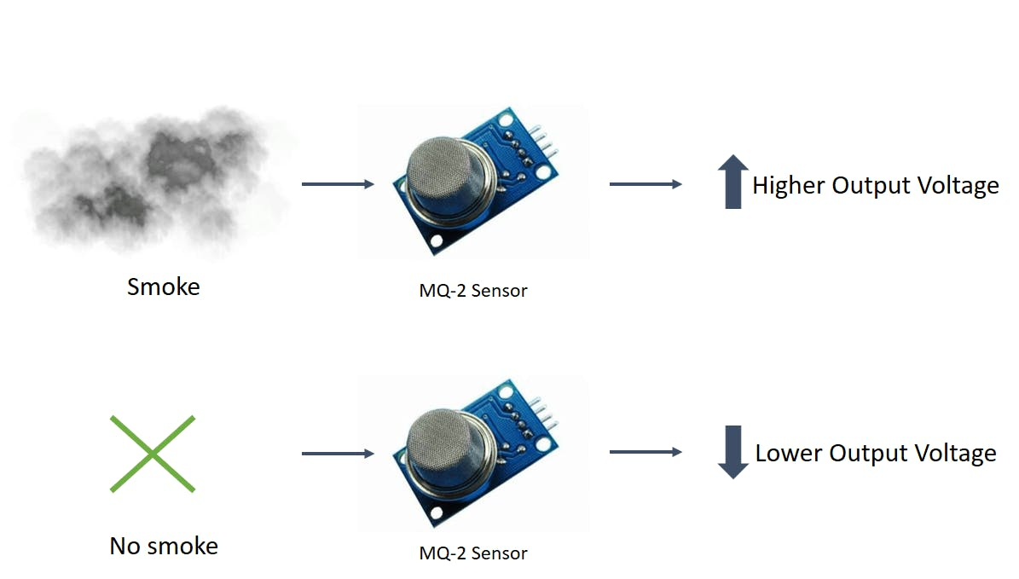

Slide 18
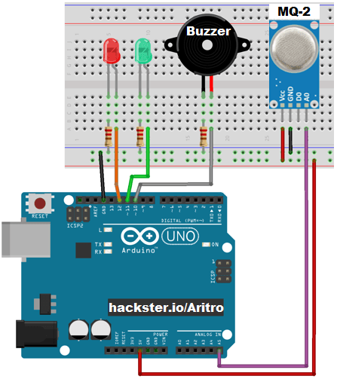
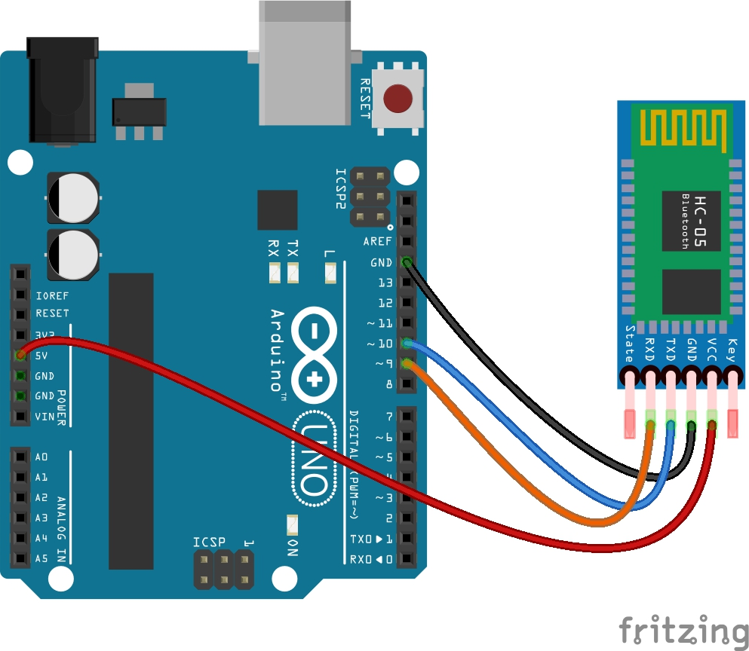
CIRCUIT

Slide 19
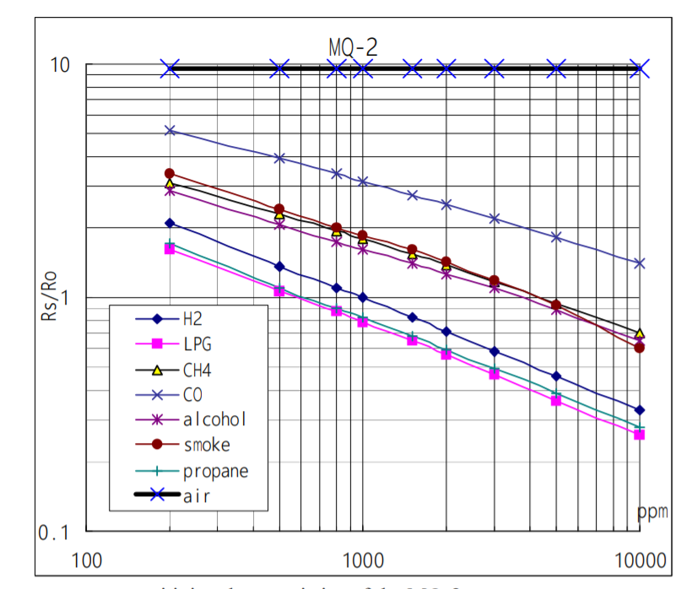
SENSETIVITY of different gasses

Slide 20
THANK YOU
(SMOKE DETECTOR)

